Slide 1
Impact of the Covid pandemic on death counts in Kinshasa: a study based on burial registers
AfriMS - The Africa Mortality Symposium
Freetown, 29-30 November 2022
Jacques B.O. Emina¹, Géraldine Duthé², Francis Loka¹,
Godefroid Djomo¹, Michel Guillot²
¹ University of Kinshasa, DRC
² French Institute for Demographic Studies INED

Slide 2
BACKGROUND : Covid pandemics in DRC
COVID-19 pandemic has claimed millions of lives, impacted people's livelihoods, their health : 646 million cases & >6.6 millions deaths (Worldwide). https://www.worldometers.info/coronavirus/
In DRC, since March 2020, 93,837 cases of COVID-19 have been confirmed, including 1,452 deaths, mostly located in Kinshasa.

Slide 3
BACKGROUND : mortality and population data
Challenges to assess direct impact of the COVID-19 pandemic in sub-Sahara Africa:
  Absence of Civil and Vital Registration Systems (CVRS)
  Effectiveness of Health Information Systems
In DRC, last census was conducted in 1984
  ~110 millions estimated for 2022
Deaths registered in the cemeteries could be an alternative source to monitor mortality trends, since most of the city's inhabitants are buried there.
  This was possible to do so in Kinshasa in DRC

Slide 4
KINSHASA: PRESENTATION
City capital of DRC
4 Districts
24 Municipalities (Communes)
Population: 16 millions
(Estimated from the 1984 census)

Slide 5
DATA & METHODS
Data sources: burial registers of 10 cemeteries out of 12 that are actively used.
Each cemetery sends a copy of the register to the urban division of the Ministry of the Interior.
Information collected: date, ID, neighborhood of residence, province of origin, sex, and age (with more or less precision) for more than 89,000 deaths registered from January 2016 to December 2021
Correction: for unknown date of death : proxy of the month of burials
Methods: Descriptive statistics of the deaths/burials series by month

Slide 6
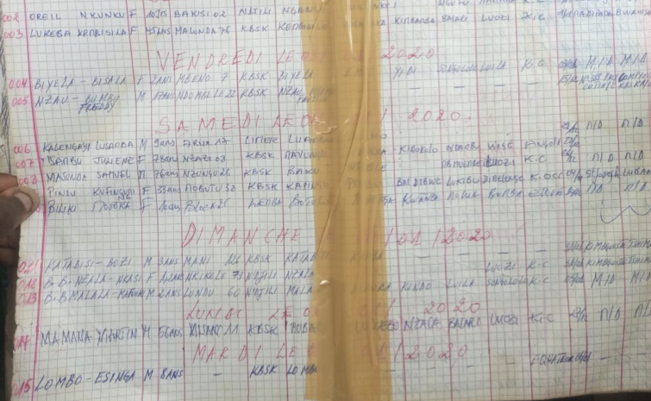
SAMPLE OF BURIAL REGISTER

Slide 7
KEY FINDINGS

Slide 8
Distribution of deaths by year of death

Slide 9
Deaths by month of death/burial – all ages

Slide 10
Deaths by month of death/burial – children <5

Slide 11
Deaths by month of death/burial – youths (5-17)

Slide 12
Deaths by month of death/burial – adults (18-64)

Slide 13
Deaths by month of death/burial – Male/female adults

Slide 14
Deaths by month of death/burial – elderly (65+)

Slide 15
DISCUSSION AND CONCLUSION
Burial registers offer opportunity to explore death trends but need to be digitized and modernized
Punctual increase of deaths of children at specific periods:
  June 2016 (Yellow fever), January 2020 (measles) and December 2020 (measles)
  No signs of COVID-19 impact
Increase in adult deaths in 2020, for both male and female adults:
  Potential direct/indirect effect of the COVID-19 pandemic
No signs of over-mortality among the elderly during the 2020
  Increase of deaths in June 2021: why?

Slide 16
DISCUSSION AND CONCLUSION
Data quality challenges:
  Data from two VIP cemeteries are not included
  Delay between death and burials, especially between December and January.
  The denominator is not known
  Lack of causes of death
  Migration flows: Kamwina Nsapu conflict in the Kasaï provinces (2016-2018) increased undocumented displacement to Kinshasa and other provinces by young adults, but there is no specific flows for the COVID-19 pandemics period.

Slide 17


Way forward: Deaths integrated surveillance systems?
CHURCH
KEY INFORMANTS/ NEIGHBOR
HOOD
SOCIAL MEDIA
Church/ Mosque
Mortuary
Burial register
Social Media
Death registration
Health Facility
Key Informants

Slide 18
Work in progress
Thank you for your questions and suggestions!

