Slide 1
Establishing high-quality mortality surveillance:
The child health and mortality prevention surveillance (CHAMPS) study in Sierra Leone, 2017–2021
Sorie I.B. Kamara
November 2022

Slide 2
Background
5.9 million children died before their fifth birthday (WHO)
Sierra Leone (SL) under-five mortality rate ranked highest in West Africa and fourth highest globally (UN_dataWPP_2019).
Vulnerable to epidemics and outbreaks: Polio, Measles, Cholera Ebola etc.
Existing Systemic challenges

Slide 3
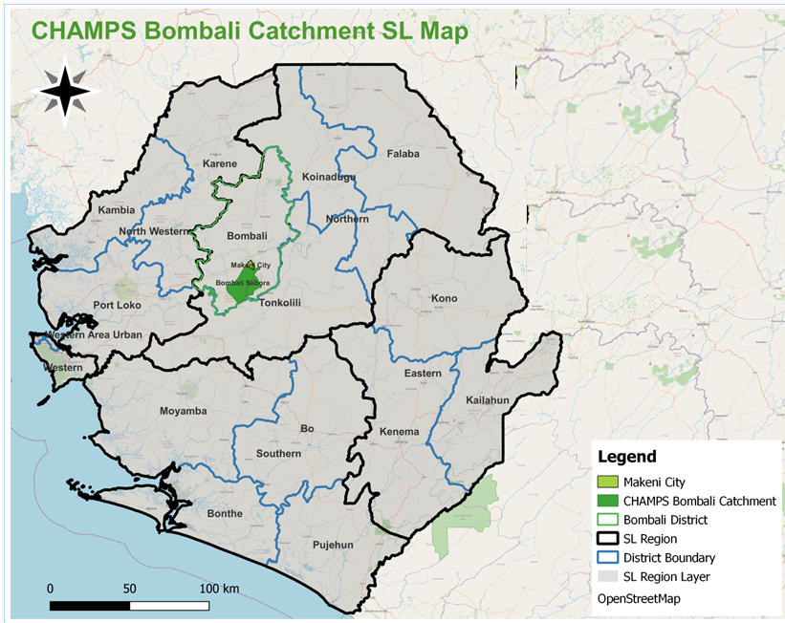
CHAMPS Overview
CHAMPS is a project that aims to collect real-time quality data on why children die in order to guide policymakers toward an evidence-based approach.
Makeni city
Bombali Sebora
Bombali Siari

Slide 4
Summary of CHAMPS Methods
Data to
Action
DeCoDe
Panel
Clinical Data, VA & SA
Local & Central Histopathology Analysis
Minimally Invasive tissue Sampling (MITS)
Reduce child mortality
Microbiology, PCR Analysis
Assign cause of death
Mortality Surveillance
Collect epidemiologic & clinical data
Social Behavioral Science
Analyze tissues
Identify pathogens
Collect specimens
Detect cases
Engage communities

Slide 5
Status of the site prior to CHAMPS implementation in 2017
Challenges:
Limited history of mortality surveillance
Limited vital event Registration
No history of autopsies at district levels
Post-Ebola time period
Low capacity on CHAMPS related work
Strengths:
Existing community & MoHS structures
Ongoing health surveillance program
Leadership and political will

Slide 6
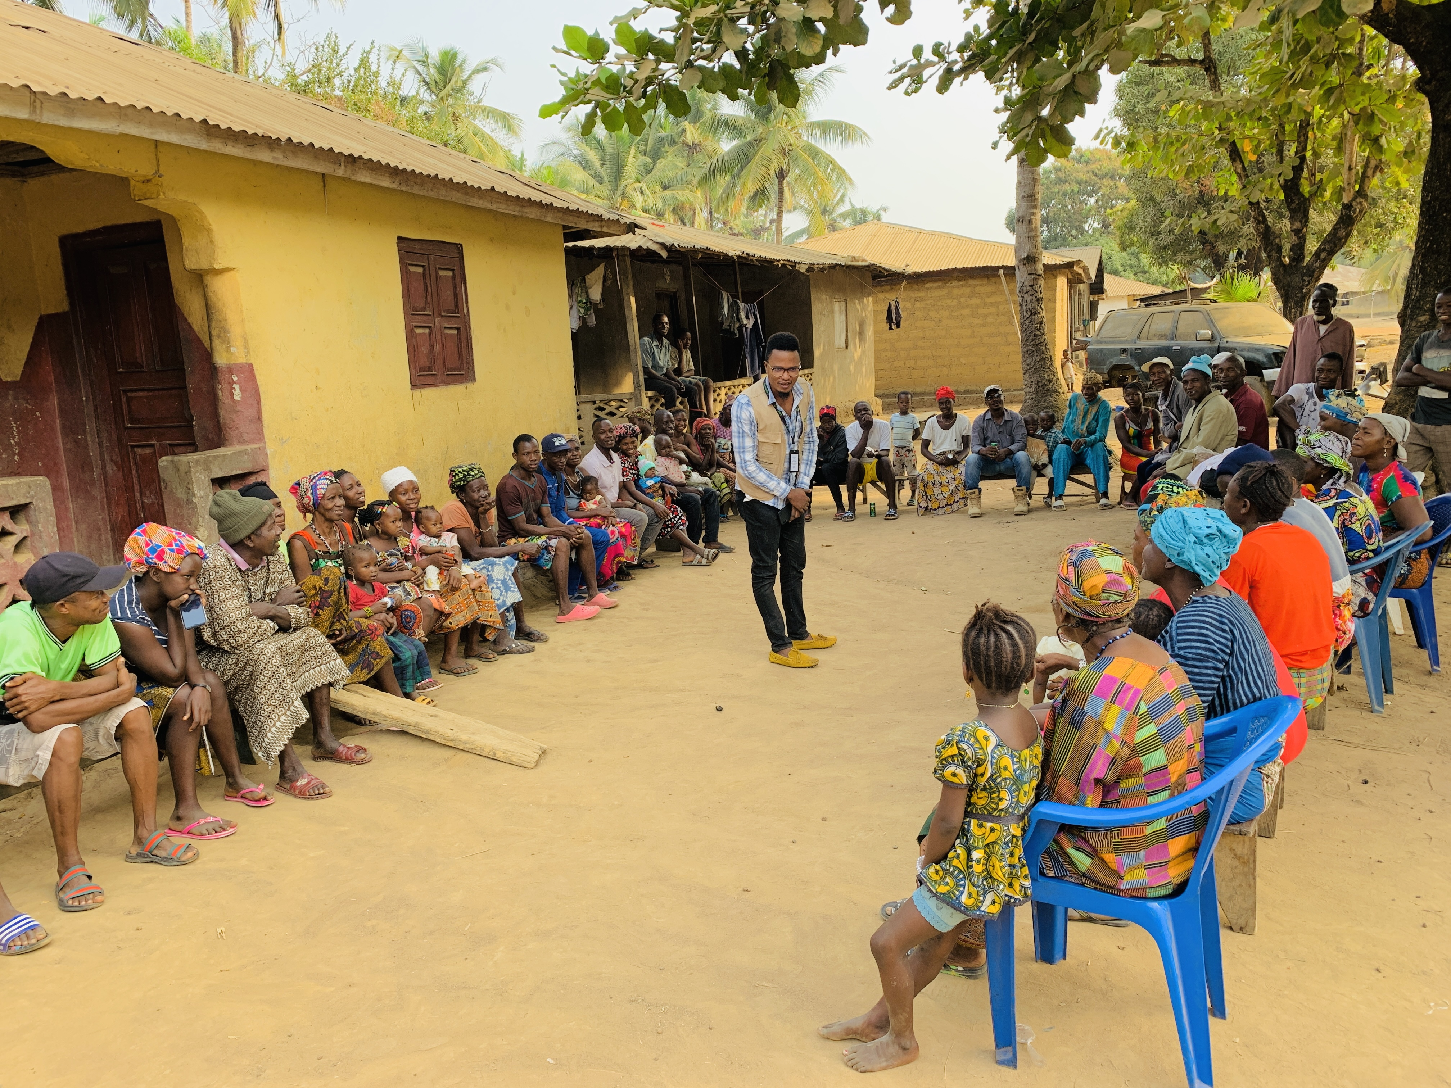
Phase 1 Social Behavioural Science (SBS) 2017
Community Entry:
Courtesy Meetings and Participatory Inquiry into Community Knowledge of CHAMPS (PICK – CHAMPS)
Feasibility and Acceptability study

Slide 7
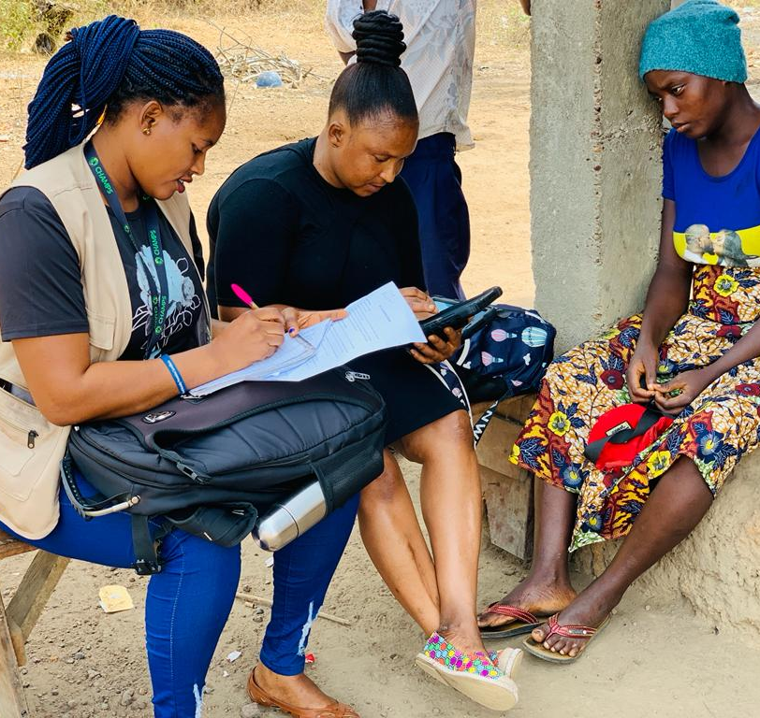
Phase 2 & 3 – Mortality Surveillance - 2017/2018
Mortality Surveillance:
Phase 2: Pilot mortality surveillance
Phase 3: Expand mortality investigations
2A - Death notifications
2B - Pilot investigations not including sample collection (non-MITS)
Further expand non-MITS data collection

Slide 8
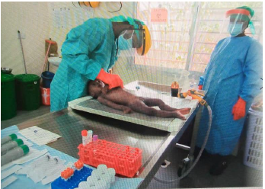
Phase 4 – Setting up MITS & Labs structures - 2018/2019
Setting up MITS Room – MITS collection
Install and Configure Lab equipment – Lab Testing
*Picture used with parental consent

Slide 9
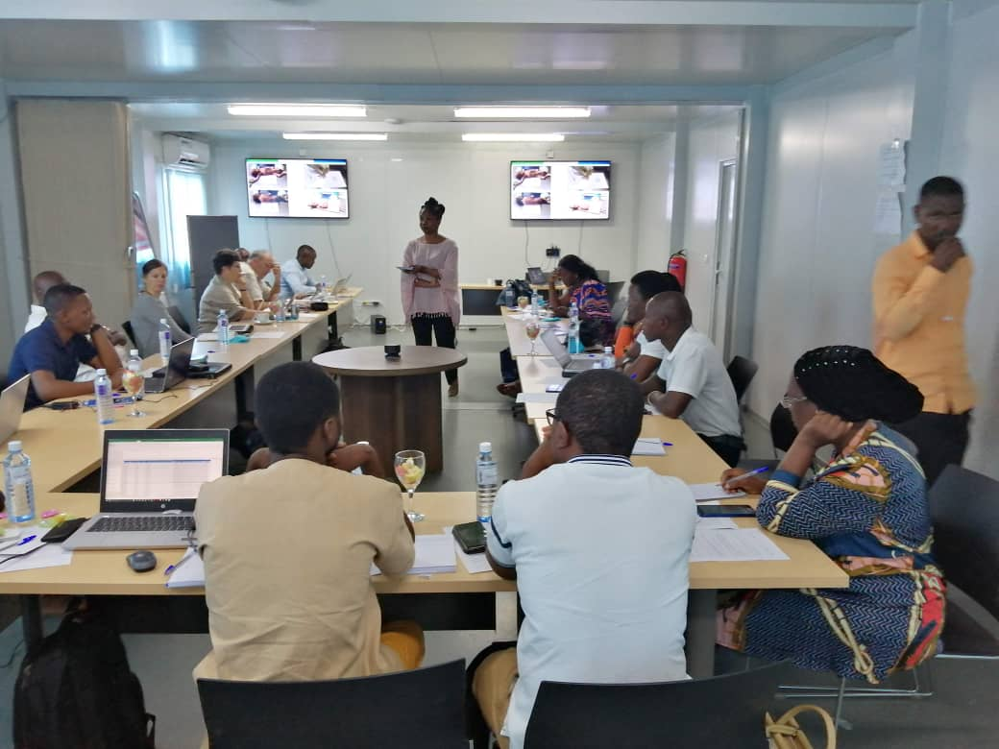
Phase 4 – Setting up DeCoDe panel - 2019
Demographic Data
Verbal Autopsy
Cause of Death Assignment
(ICD-10 and ICD-PM)
Clinical Abstraction
Child and Maternal
MITS Collection Data
Anthropometrics
Photographs
Molecular Diagnostics
TAC Results
Other Diagnostics
Blood and CSF culture
HIV (PCR)
TB (GeneXpert)
Malaria blood smears and RDT
Pathology Results
Site pathology report
CDC Central Pathology Laboratory: special stains, immunohistochemistry
Whole slide images

Slide 10
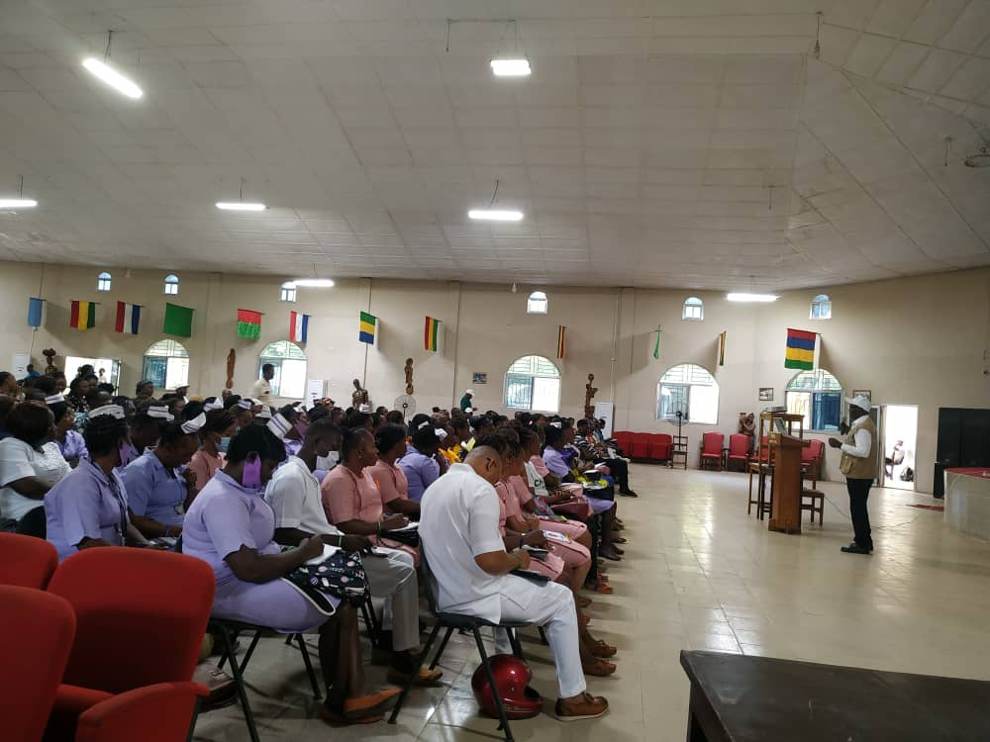
Phase 4 – Setting up Data to Action - 2020/2021
IPC–SCBU cleaning
Clinical records management
Healthcare workers’ forum
Clinical review meetings
Emergency drugs support

Slide 11
Initial Outcomes of CHAMPS Implementation
High level of community and facility involvement
2855 death notifications
390 MITS performed: 82% consent rate
Average of 56 unique notifications and 15 MITS per month
77% of MITS cases DeCoDed
Over 1,000 community and healthcare workers have participated in CHAMPS Data to Action activities.

Slide 12
Initial Outcomes of CHAMPS Implementation Con.
Provided definitive cause(s) of death
Capacity building
Data to action outcomes
Dissemination of CHAMPS data and findings
Established platform for other research work
Support government effort in response to outbreaks – COVID 19

Slide 13
Conclusion
It is possible to implement a high-quality mortality surveillance in a challenging context such as Sierra Leone
Building on local knowledge and infrastructure has enabled the CHAMPS project to achieve unprecedented consent rates while upscaling local technical capacity for surveillance and laboratory diagnostics.

Slide 14
Acknowledgements
Families who agreed to participate in CHAMPS
Bill & Melinda Gates Foundation
Community stakeholders of Bombali District and the Two Chiefdoms
Other Partners working with CHAMPS
CHAMPS Program Office
SL CHAMPS Staff

Slide 15
Thank you

