Slide 1
Feasibility of Minimally Invasive Tissue Sampling (MITS) in a home setting in Butajira, Ethiopia
Africa Mortality Symposium (AfriMS)
Nov 29 -30, 2022
Notes:
Notes:
We need to add the subject on the title

Slide 2
Outline
Introduction
Objectives
Methods
Results and discussion
Notes:
move the community sensitization procedure and results in to the methods section
Add the estimates of stillbirth and neonatal death in Ethiopia

Slide 3
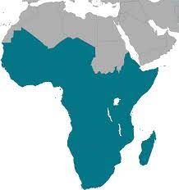
Introduction
Neonatal Mortality & still birth
Three-quarter deaths – first week
Highest risk of death - first day of life
~ 2 million stillbirth in 2019
Stillbirth rates around the globe ranged from 1.4 to 32.2 per 1,000 total births in 2019
Ethiopia
Highest neonatal mortality
37.9 deaths per 1000 live births in 2008*
29 deaths per 1,000 birth **
Stillbirth rate of 24.6 per 1000 live births
One of the six countries that contribute to 1 million stillbirths across the globe
38% of global neonatal death
Stillbirth rate of 21.7 per 1,000 total births*
Seven times higher than the lowest regional rate of 3.1
*UN inter-agency group for child mortality (UN IGME) estimates
** EDHS 2016

Slide 4
Intro(2)
MITS implementation
CHAMPS - Health facility setting is promising
Place of death in LMICS: 60-70 % at home
Only capture 15 - 20 % of deaths that occur at home
Accurate picture of the causal distribution → capturing a representative sample of home deaths is fundamental

Slide 5
Objective
The objective of this study is to assess the feasibility of conducting MITS in the home setting

Slide 6
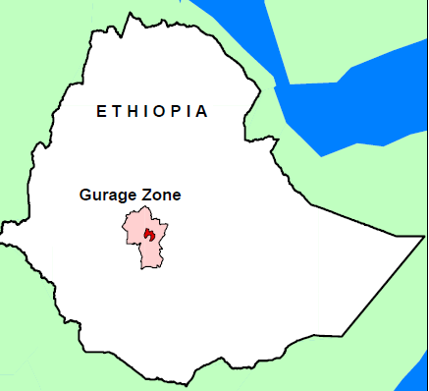
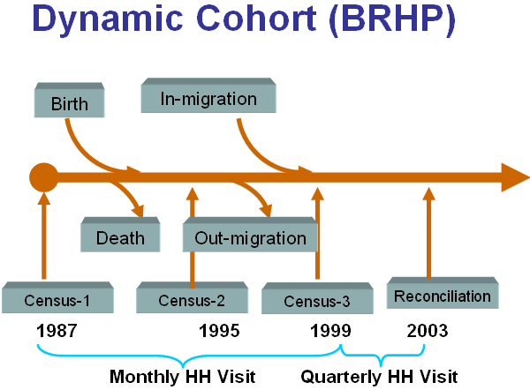
Methods
Setting
Butajira HDSS
Design:
Open- Cohort
Gurage Zone, SNNPR, Ethioipa
Meskan, Silti and Mareko districts (9 rural, 1 urban)
Surveillance
4 Rounds of data collection
Total popn: 56,781 in 2021
Census on 10 Additional kebeles
Target population → 140, 000

Slide 7
Procedures
Methods(2)
Notification
Community Health Agents
RE
Preparation
MITS
Community orientation
Tissue sampling
Clinical Team (Nurses) from Hospital
HDSS field coordinators
Notes:
* Inputs obtained from community sensitization , @ prior to notification started
ill wish (from parents)
fatwa from religious
Additional community sensitization in schools
Leaflet distribution

Slide 8
Results
Characteristics | Frequency (n)
Availability of window
Yes | 12
No | 2
Material on which MITS was performed
Table | 3
Chair | 3
Matted floor | 8
Age of the mother
Median (IQR) | 32 (17)
ANC attendance for index pregnancy
1 visit | 0
2 visits | 4
3 visits | 7
4 visits | 3
December 8, 2021 – August 15, 2022
21 notifications
2 not feasible → night time
1 late notification (> 24 hrs.)
4 refused
14 consented

Slide 9
Results (2)
MITS case description
Notification to specimen collection
All with in 24 hours
MITs with in 1 hr. of notification for 11 cases
33 minutes – Specimen collection
Characteristics | Frequencies (n=14)
Age groups
Still birth | 8
Death In the first 24hrs | 2
Early neonate (1 to 6 days) | 3
Late neonate (7 to 28 days) | 1
Sex
Male | 6
Female | 8
Time from death to Notification
≤ 24 hrs | 14
> 24 hrs
Time from notification to MITS procedure
> 30 minutes – 1 hr | 11
> hr – 2 hrs | 1
> 2 hrs | 2
Time taken for MITS procedure (in minutes)
Mean (SD) | 33.3 (5.72)

Slide 10
Discussion
Consent
MITS in a home setting is readily accepted
Rate of notification
Compared to the expected number of deaths at home, notified cases are relatively low
Proportion of home deaths accounts about 53 % even in HDSS (Paganelli CR et al 202, Price J et al 2019)

Slide 11
Discussion (2)
Feasibility
MITS within 24 hours of receiving case notification
Indicative of feasibility of MITS implementation at home
Without the need to transport the body to the health facility
Systematic surveillance of death and timely notification
Approaching families through staffs of HDSSs may have improved acceptability
Rigorous studies are warranted with larger number of cases and various settings

Slide 12
Discussion (3)
Challenges:
Certainty on actual number of cases
Outside of HDSS (surveillance)
Need to carry out tissue sampling in short time – Sample quality
Need to bury the body soon
Interference by uncounseled relatives
small size of households
Family discomfort due to the high pitch “clicking” sound of the syringe

Slide 13
Conclusion
Conducting MITs procedures in a home setting is adequately feasible
The number of notified deaths is small, compared to estimated death
Impedance on the feasibility of MITS outside HDSS settings

Slide 14
Thank you!
Photo credit
@abonthestreet

